Slide 1
Digital Portfolio
B. MEENA
STUDENT NAME:
NMID: autunm1667saz241667413
DEPARTMENT: BACHELOR OF COMPUTER APPLICATION
UNIVERSITY: MADRAS UNIVERSITY

Slide 2
PROJECT TITLE
MY PORTFOLIO

Slide 3


AGENDA
Problem Statement
Project Overview
End Users
Tools and Technologies
Portfolio design and Layout
Features and Functionality
Results and Screenshots
Conclusion
Github Link
3/21/2024 Annual Review

Slide 4

PROBLEM STATEMENT:
In today’s digital era, a personal portfolio website has become essential for professionals, especially developers and designers, to showcase their skills, projects, and experience. Traditional resumes and CVs do not fully reflect creativity and interactivity. A well-structured portfolio allows individuals to demonstrate their technical knowledge and creativity while making a strong first impression.

Slide 5

PROJECT OVERVIEW:
This project is a personal portfolio website designed and developed using HTML, CSS, and JavaScript. The portfolio highlights personal details, skills, projects, and contact information in a visually appealing and responsive layout. It consists of the following main sections: Home / Hero Section – Introduction with profile picture and title. About Section – Short description about me. Skills Section – Technologies and skills I have learned. Projects Section – Display of projects with descriptions. Contact Section – Ways to connect with me.

Slide 6

WHO ARE THE END USERS?
Recruiters looking for skilled candidates. Clients seeking freelancers for web development or design work. Peers/Students who want to see examples of portfolio design. Myself – as a professional online identity.

Slide 7

TOOLS AND TECHNIQUES
Frontend Languages: HTML5, CSS3, JavaScript Styling: CSS Flexbox, CSS Grid, Responsive Design Code Editor: VS Code Version Control: Git & GitHub Hosting (Optional): GitHub Pages / Netlify

Slide 8
POTFOLIO DESIGN AND LAYOUT
Header & Navigation – Sticky top navigation bar with smooth scrolling. Hero Section – Profile picture, introduction, and tagline. About Section – A brief biography and career goals. Skills Section – Highlight of technical expertise. Projects Section – Grid layout to showcase completed work. Contact Section – Links to social media and email. Footer – Copyright details. The color theme used is dark mode
8

Slide 9
FEATURES AND FUNCTIONALITY
The portfolio website is fully responsive, ensuring compatibility across mobiles, tablets, and desktops. It features smooth navigation with hover effects, a circular profile picture for a professional look, and integrated social media links. Projects are displayed in a clean card-based layout, and the overall design follows a modern and user-friendly interface.

Slide 10
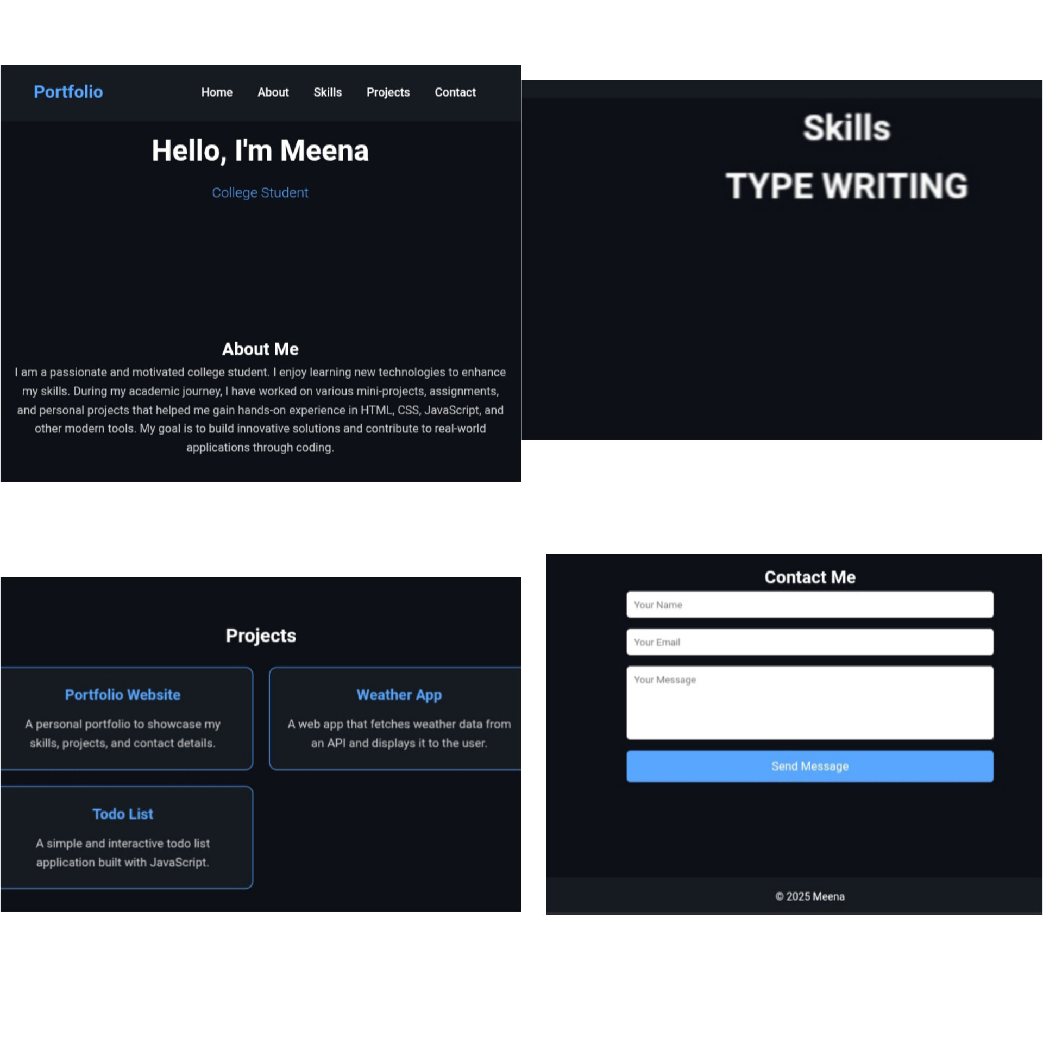

RESULTS AND SCREENSHOTS
3/21/2024 Annual Review
10

Slide 11
CONCLUSION
This portfolio project successfully demonstrates how HTML, CSS, and JavaScript can be used to build a professional website. It serves as an online resume and showcases both technical ability and creativity. With future improvements, such as animations, blogs, or backend integration, the portfolio can become even more interactive.
11

